Slide 1
Team 2
9/1/2021
11:30 am Mondays Discord meetings Victoria Gammenthaler, Lisa Chen, Sreya Nagumalla Michael Stinnett, Tyler Mooney, Michael Menjivar

Slide 2
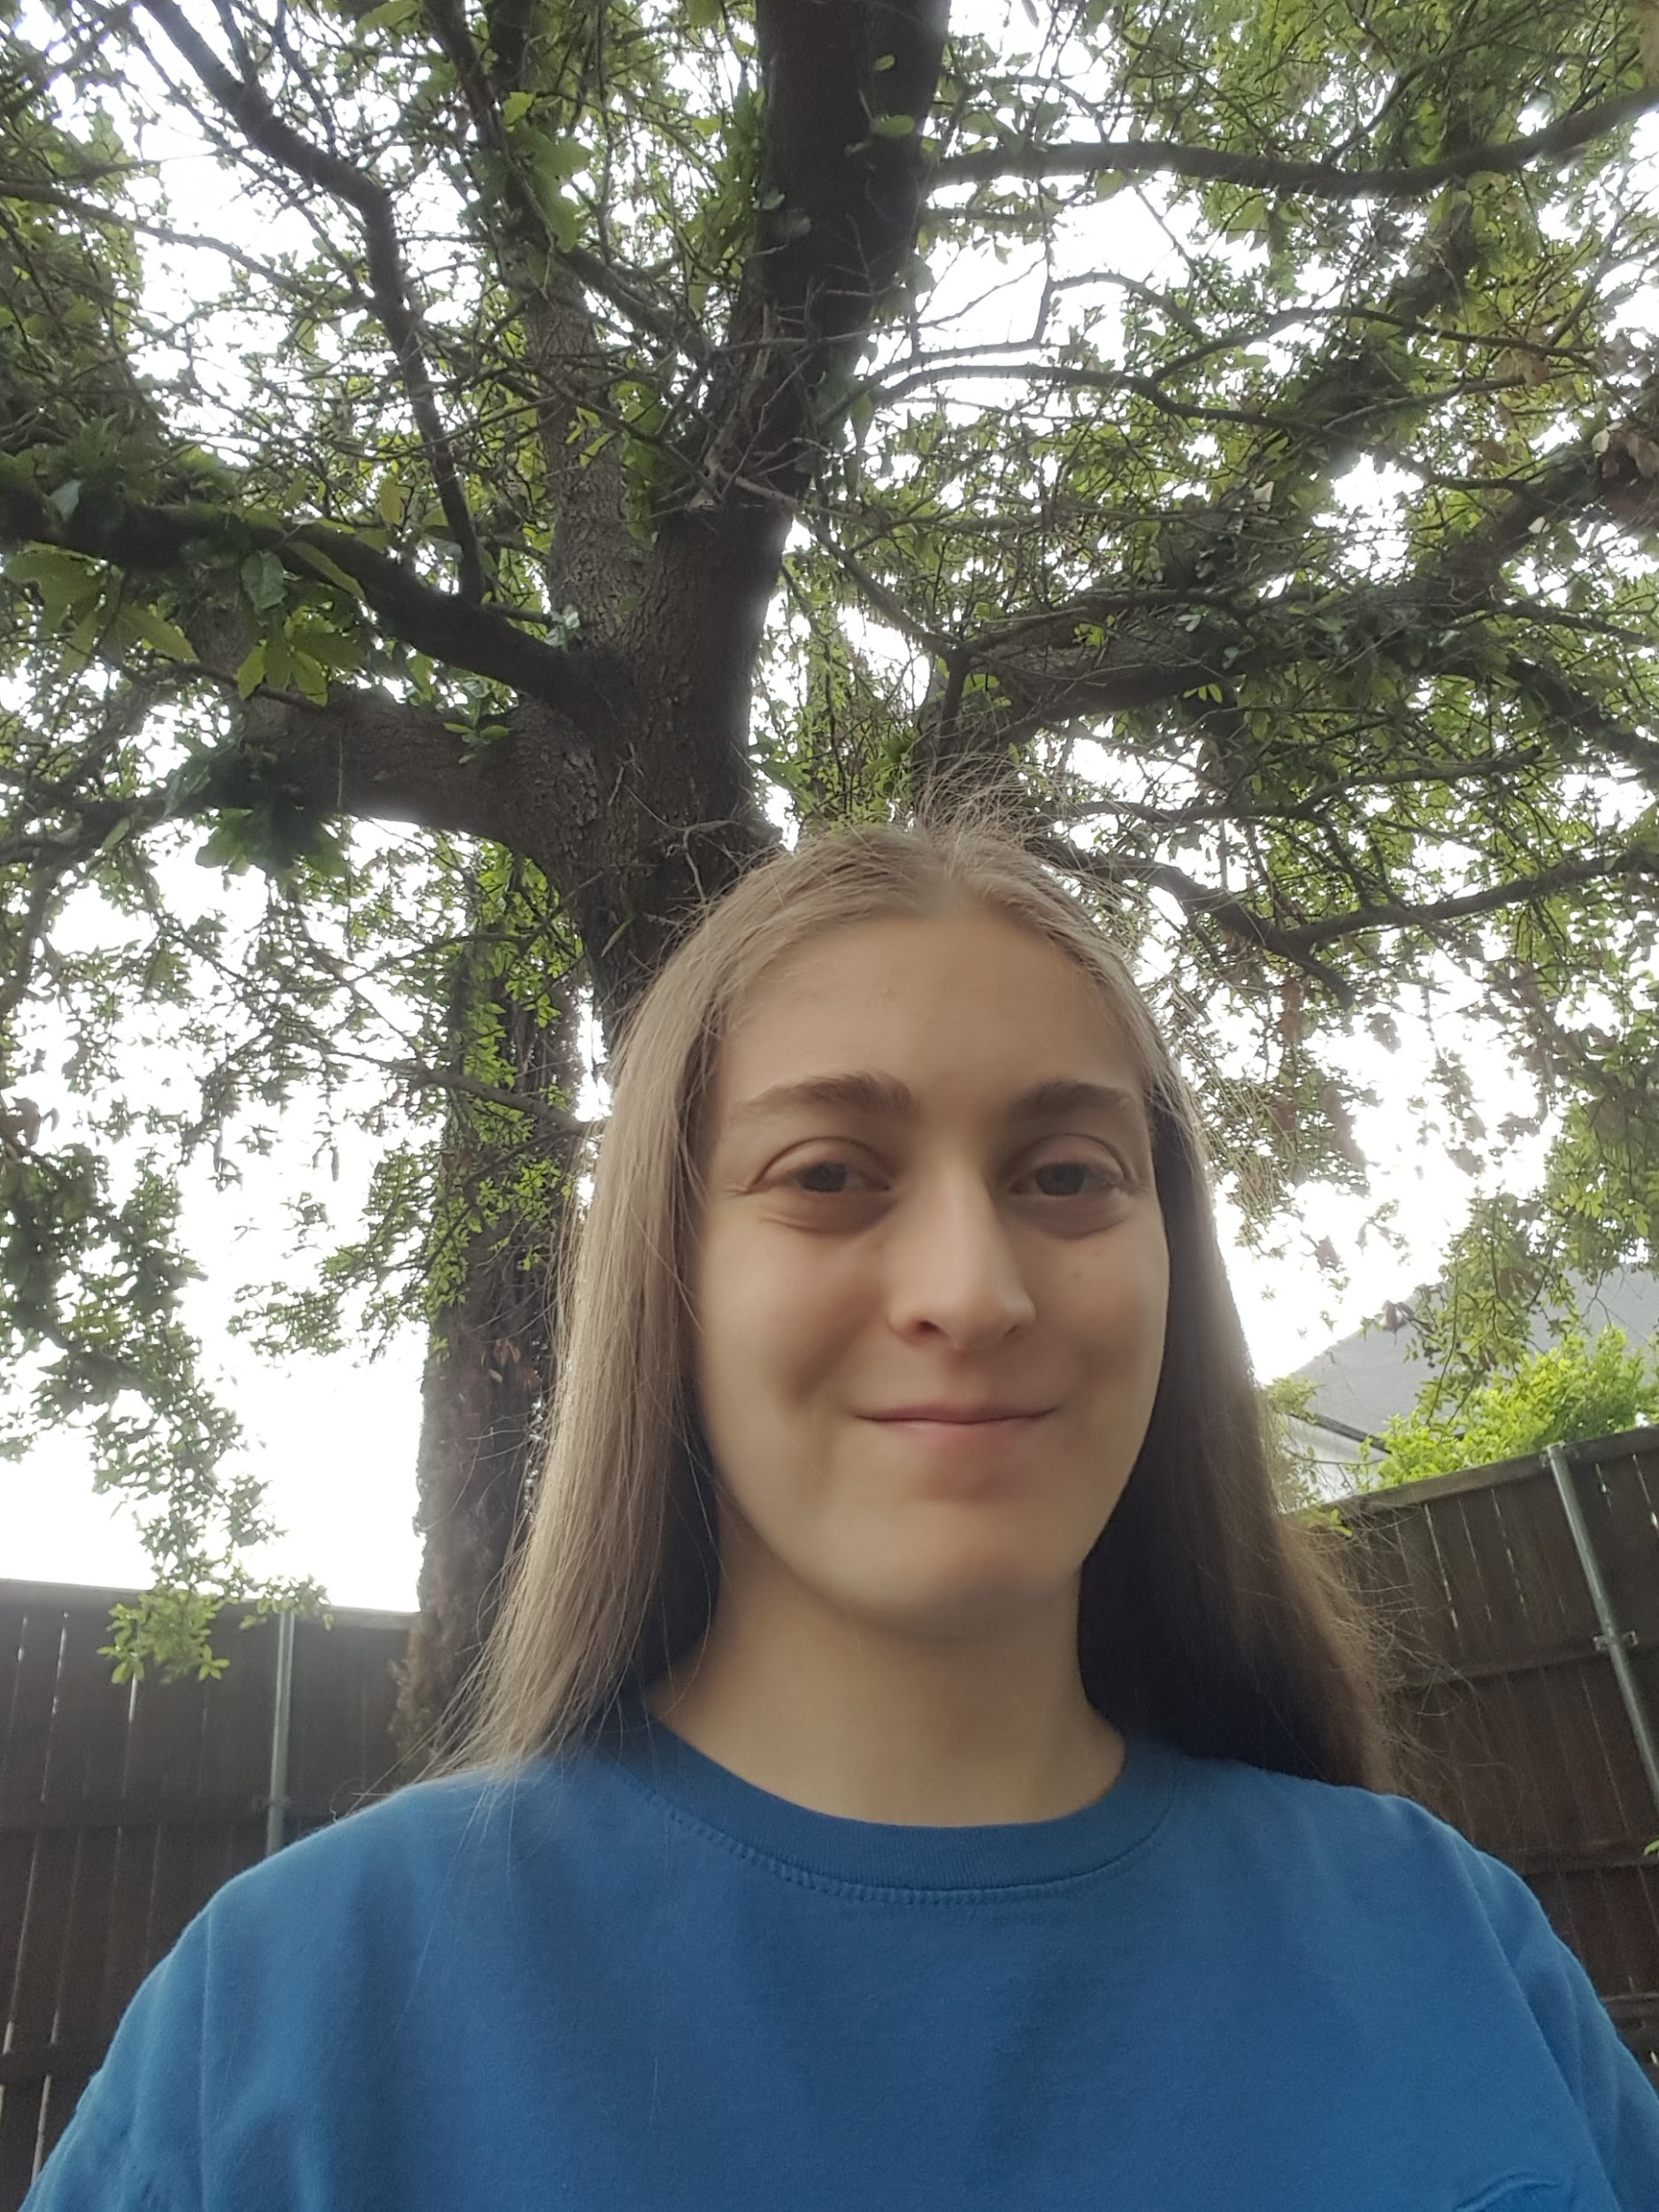

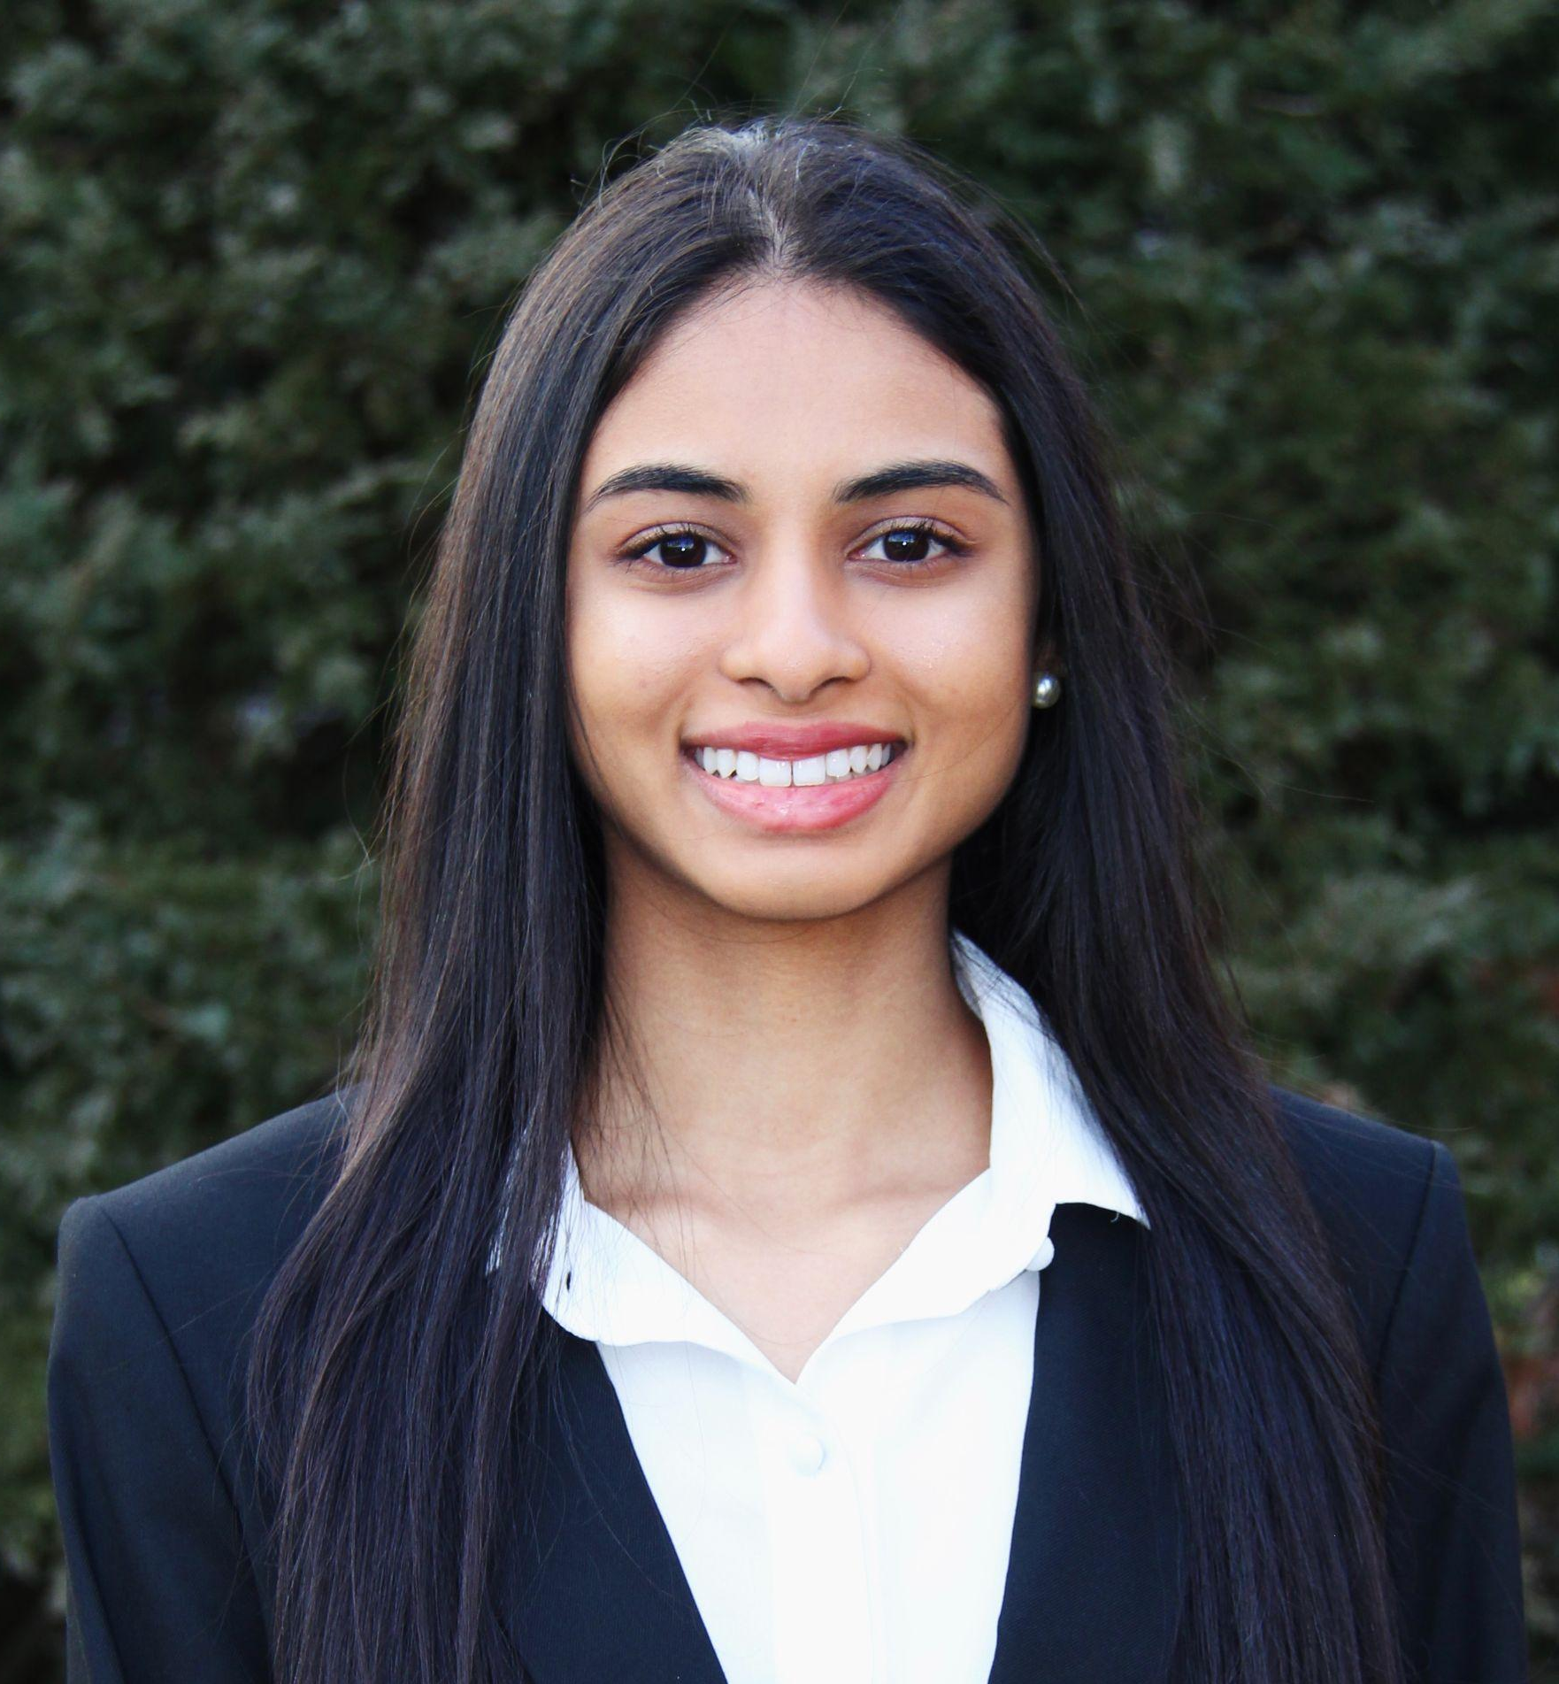



Victoria Gammenthaler
Frisco, TX
Computer Engineering
Unemployed
I have two cats.
Lisa Chen
Dallas, TX
Computer Science
Unemployed
I enjoy forensic science.
Sreya Nagumalla
Milford, CT
CS & Data Analytics
Unemployed
I once memorized 370 digits of pi!
Michael Stinnett
Oklahoma City, OK
Computer Science
Unemployed
I can whistle and hum at the same time!
Tyler Mooney
Lewisville, TX
Software Engineering
Unemployed
I’m a discount Michael Reeves.
Michael Menjivar
Houston, Texas
Computer Science
Unemployed
My favorite color is pink.

Slide 3

Selected Project used to create the SOW: Service/Website
Opinion Mining for Social Network Platforms Service/website

Slide 4

Project idea
Opinion Mining

Slide 5
What is your rationale behind the project
Michael Stinnett
Opinion mining methodologies are used by most top companies to cater better to consumers.
Political campaigns abuse opinion mining methodology, understanding how it works can be crucial in being an informed citizen.
Michael Menjivar
We want to understand the opinions of UTD students on UTD.
I like to know what people are thinking about, and it’s interesting learning about what people attending UTD think of their own university.

Slide 6
What is your rationale behind the project
Victoria Gammenthaler
Companies use opinion mining on social media platforms to know what advertisements to show to a consumer
To know the mindset of a community in a social network platform
Tyler Mooney
Opinion mining is essential for political campaigns to understand how promises and messages used are perceived by the general public.
Opinion mining is vital to condensing and understanding what the populous is thinking across multiple platforms of communication.

Slide 7
What is your rationale behind the project
Lisa Chen
To better understand how opinion mining works to collect its data on social media
Opinion Mining will allow us to see how people’s opinion changes over time and I would like to see the flow of that
Sreya Nagumalla
End Users are a priority, so opinion mining will help us store all data and carefully analyze the important findings about them
We can use opinion mining as a strategy to understand the audience and efficiently market on social media platforms

Slide 8
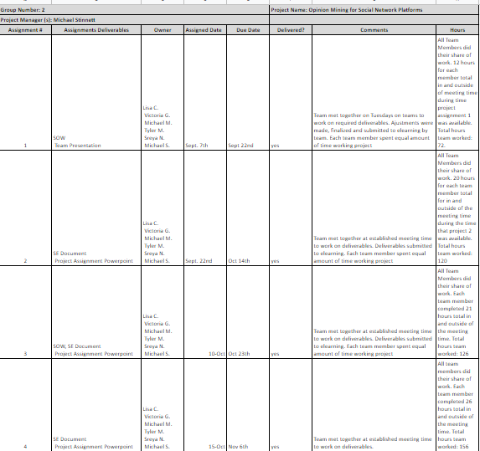
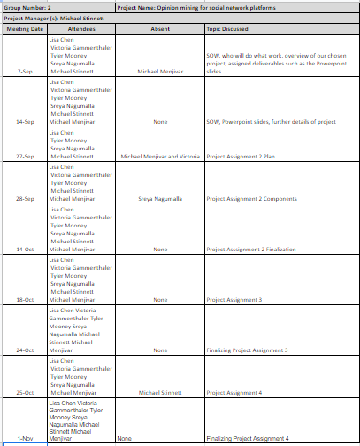
Action Register
Notes:
Update as needed

Slide 9
Cost of Application
Development: $15,390
Requirements Analysis: $14,310
Deployment: $50
Infrastructure: $50 per month

Slide 10
Functional Requirements
Opinion Mining:
View results in a list view
View graphs in a grid format
View menu to filter search results
Check and uncheck filter options
View the comments posted by other users
View other user’s topics & comments as a list
View individual posts and see how they were tagged
Filter search results by most positive/negative opinions
View the most closely related result at the top of the results
View topics/comments by weight class (Good, Bad, Worst)
Give application user’s social media accounts for access points
Check/uncheck chosen key phrases used in the mining algorithm
Filter search results based on the platform an opinion is mined from
Click on a particular topic or post and provide their take on the matter
Page in application:
Sign in
View searched results
Start searching for opinion after logging in
View timeline graph and charts of opinions on topic/post
View trending topics/posts that can be selected and explored
Requirements for Accounts:
Create account
Delete account
Download data
Log out of account
Change account settings
View users' public information
Save login info on login page
Go to linked friend’s information
Block people from being linked friend
View signed-out version of application
Link with friends from social media accounts
Disconnect connected social media accounts
Switch account mode between public and private
Go to profile page with connected social media accounts

Slide 11
Non-functional requirements
The application should:
Be able to run on a PC, IOS, and Android OS browser.
Be able to log users in within 5 seconds
Be online 99% of the time.
Have a mobile friendly version
Load any page in under 5 seconds
Load any search result in under 3 seconds
Be able to sign a user out in under 5 seconds.
Be user friendly and easy to use.
Be readable in PC and mobile versions.
Have font and format should look professional.
Create an account, after user inputs needed information, in under 5 seconds
Be able to update account settings in under 5 seconds.
Notes:
Summary on 1 slide

Slide 12
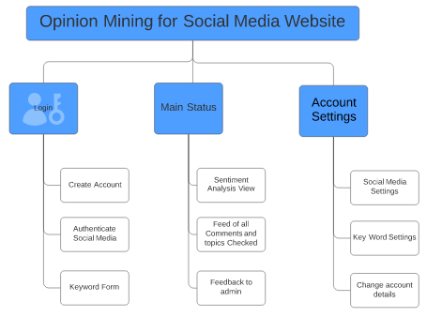
Site Map

Slide 13
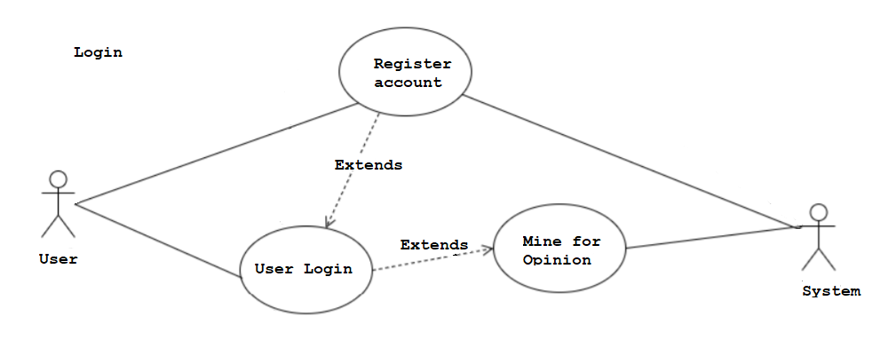
Use Case #1: Login

Slide 14
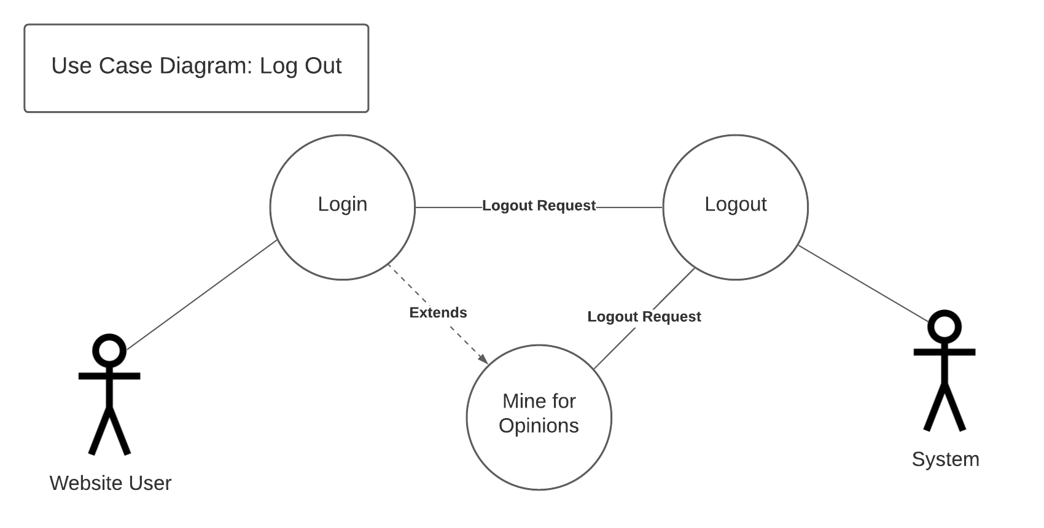
Use Case #2: Logout

Slide 15
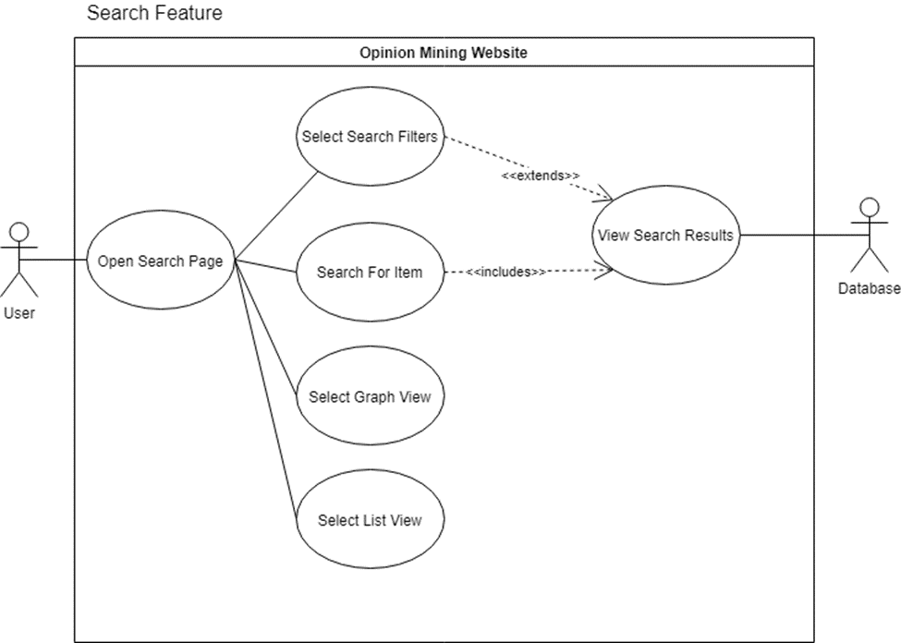
Use Case #3: search

Slide 16
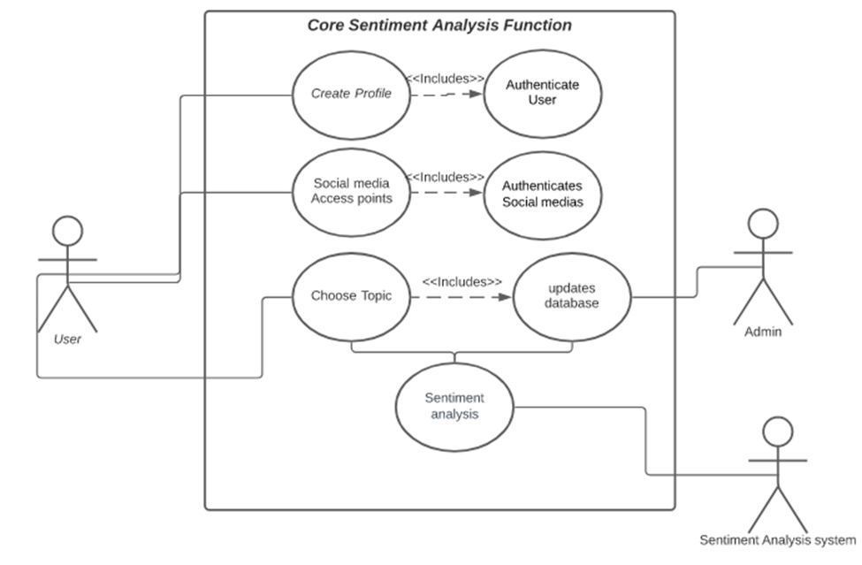
Use Case #4: core sentiment analysis function

Slide 17
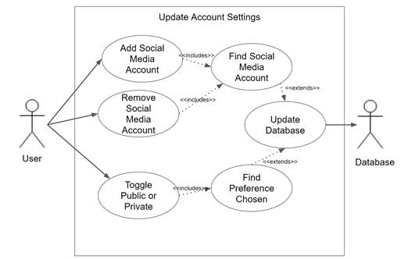
Use Case #5: update account settings

Slide 18
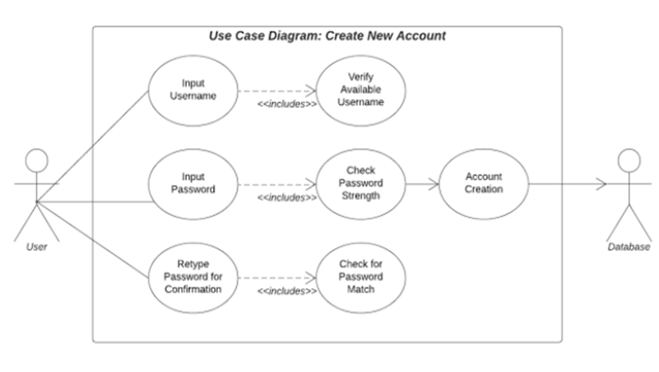
Use Case #6: create new account

Slide 19
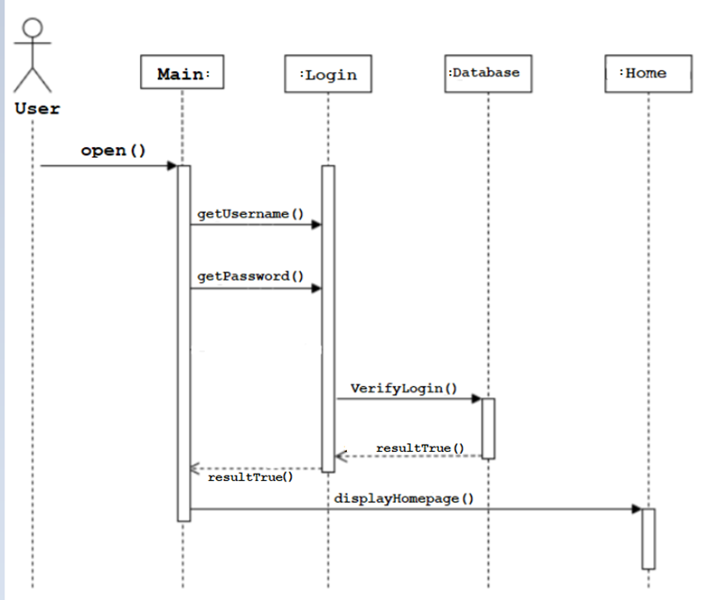
Sequence Diagram: login

Slide 20
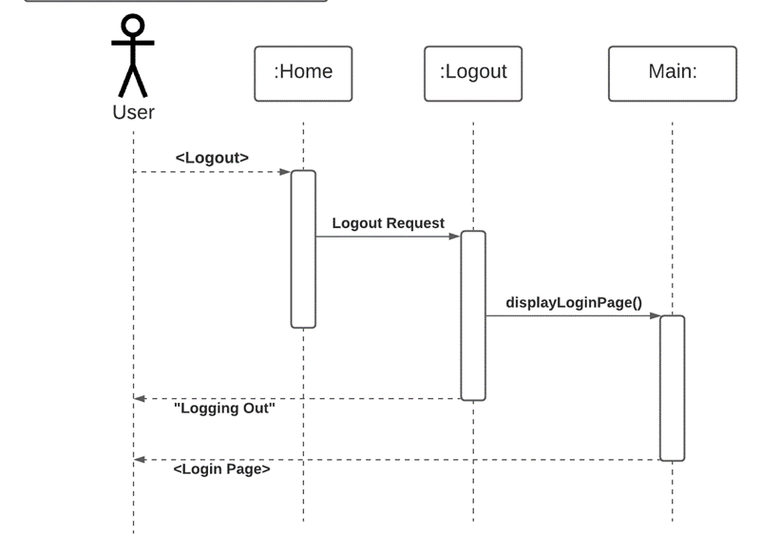
Sequence Diagram: logout

Slide 21
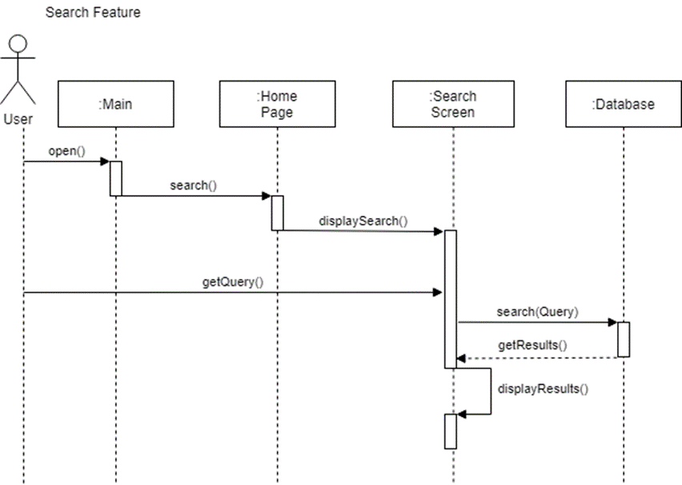
Sequence Diagram: Search

Slide 22
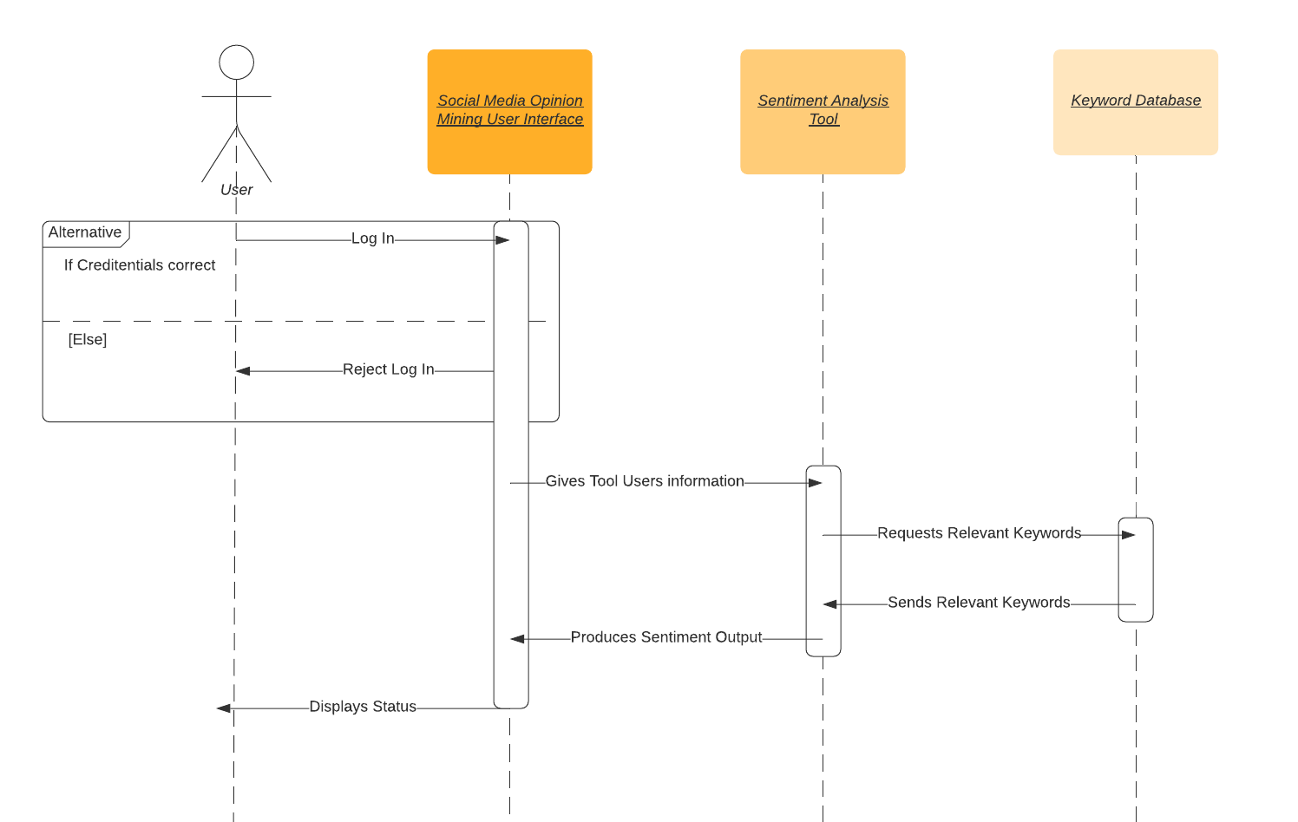
Sequence Diagram: Core Sentiment Analysis Function

Slide 23
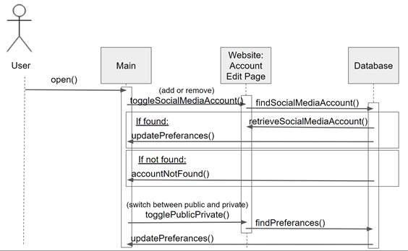
Sequence Diagram: update account settings

Slide 24
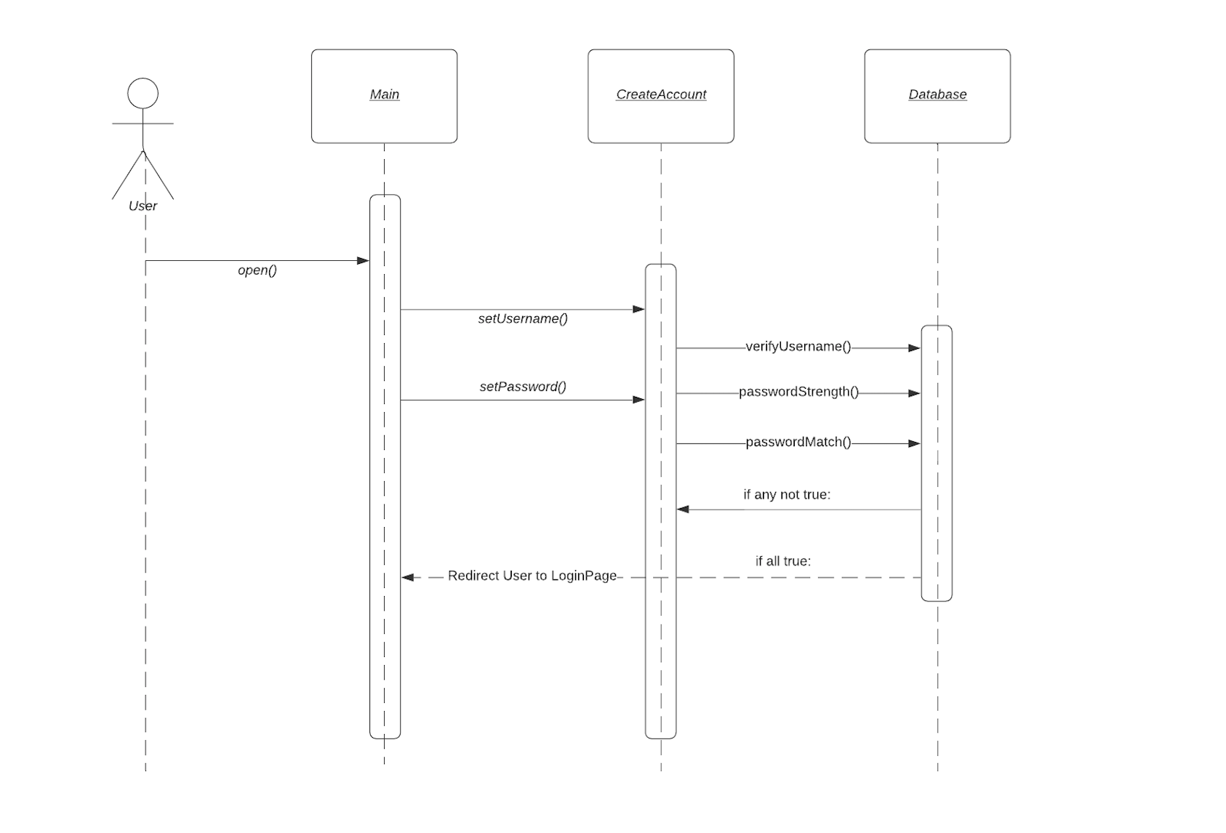
Sequence Diagram: Create New Account
Notes:
In order to change the image, you must do the following
1. Copy the image to your clipboard or save the image to your device
2. Right click the image and choose the appropriate option to change the image
3. If formatting is off:
3a. Right click the image and select format picture
3b. Click the picture icon
3c. Adjust the values of the “Crop” category
3d. Adjust specifically the “Crop Position” category

Slide 25
Test Cases
Sign In Test (Test #F1)
Execution: Sign in with each combination of right and wrong password and username.
Acceptance Criteria: Fail for all combinations except for the right username and password.
Disconnect Social Medias Test (Test #F7)
Execution: Sign in and click the account settings page, click remove button next to respective social media site.
Acceptance Criteria: Remove is successful. There is no longer analysis from that social media site in the main status page.
Search Result Time Test (Test #NF6)
Execution: Use the search function.
Acceptance Criteria: All results should display in under 3 seconds.
Uptime Test (Test #NF3)
Execution: Use any part of the application.
Acceptance Criteria: Every part should be online 99% of the time.

Slide 26
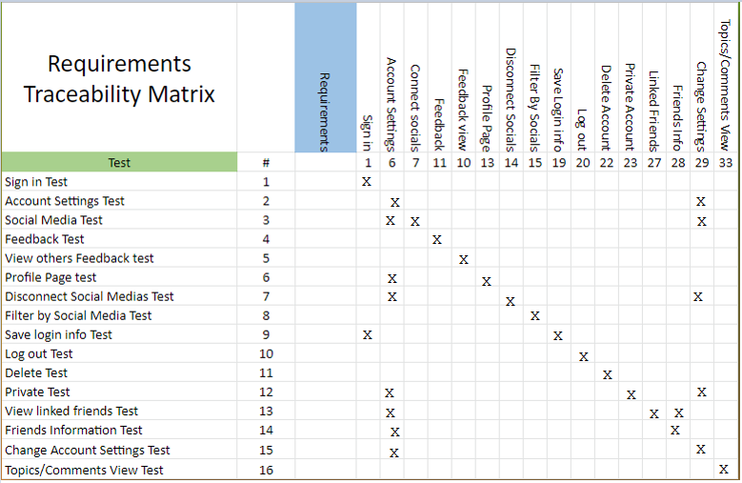
Requirements Traceability Matrix (RTM): Functional Requirements

Slide 27
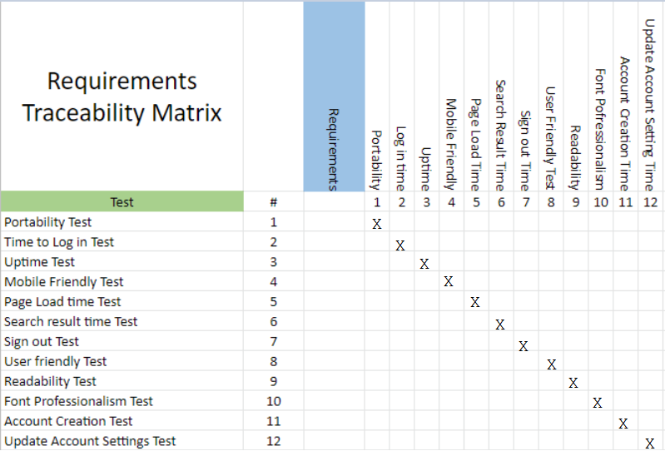
Requirements Traceability Matrix (RTM): Non-Functional Requirements

Slide 28
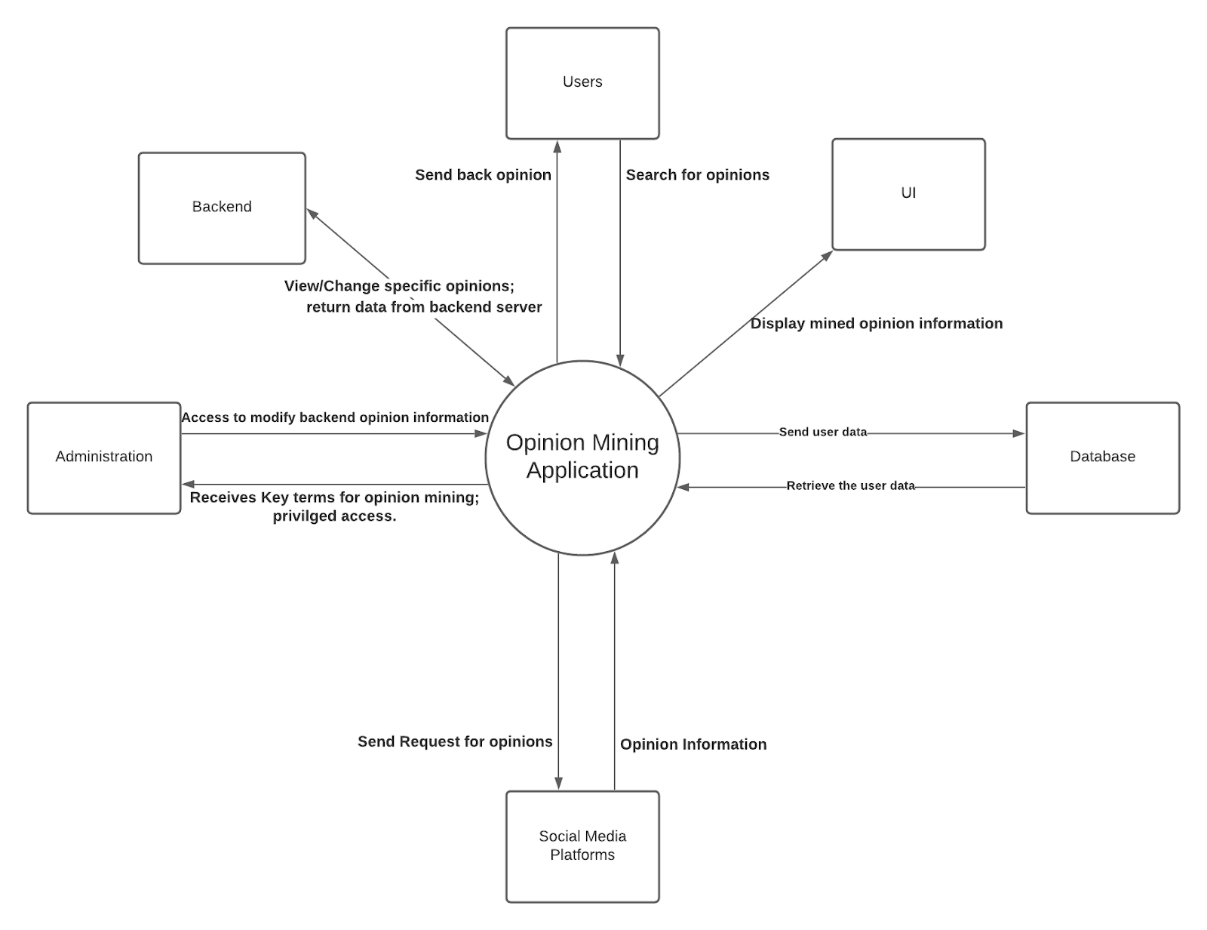
Context Diagram

Slide 29
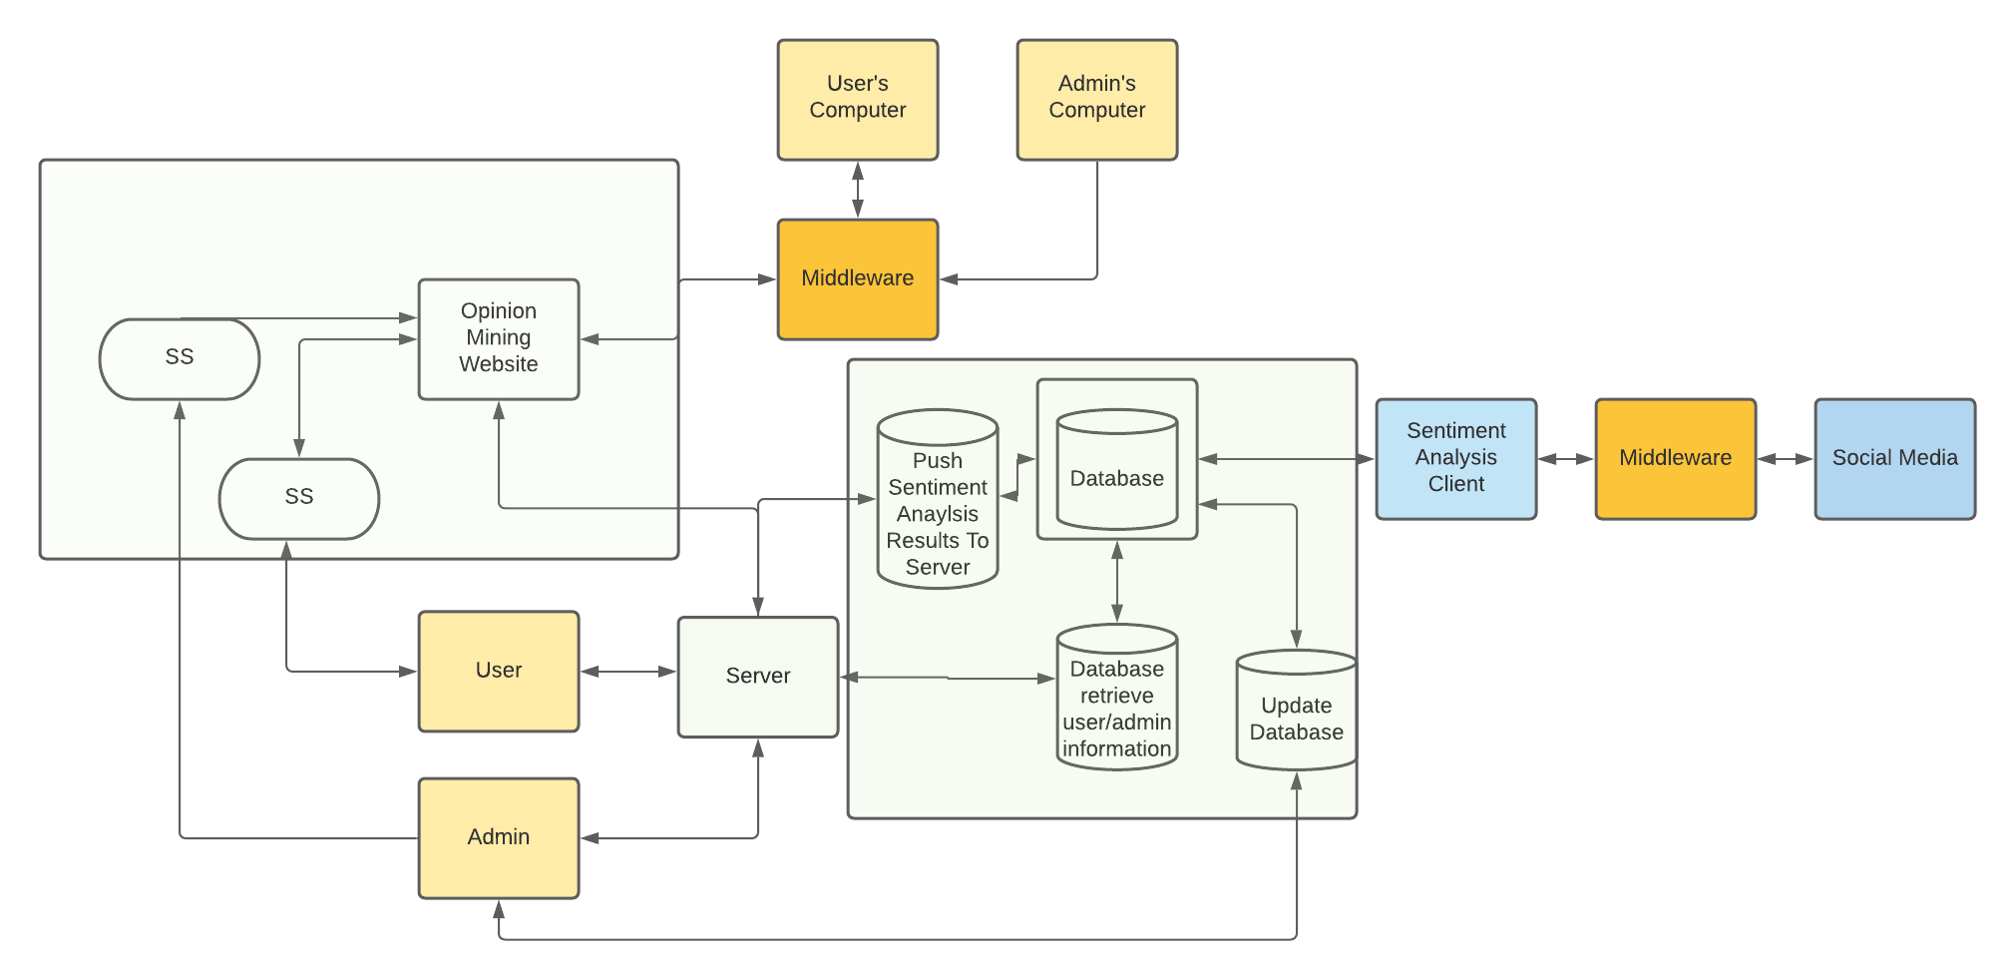
System Architecture (Logical View)

Slide 30
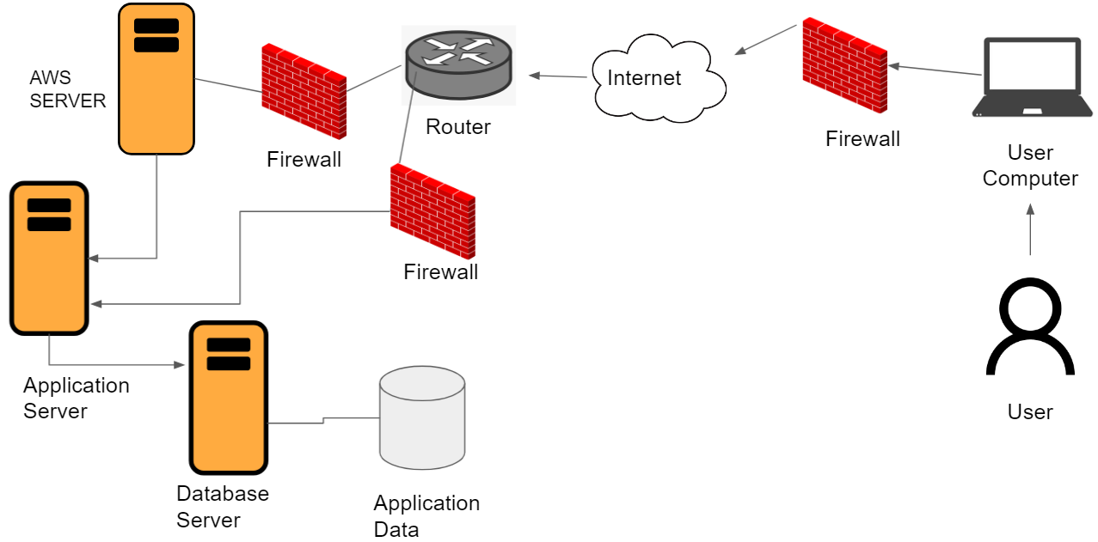
System Architecture (physical View)

Slide 31
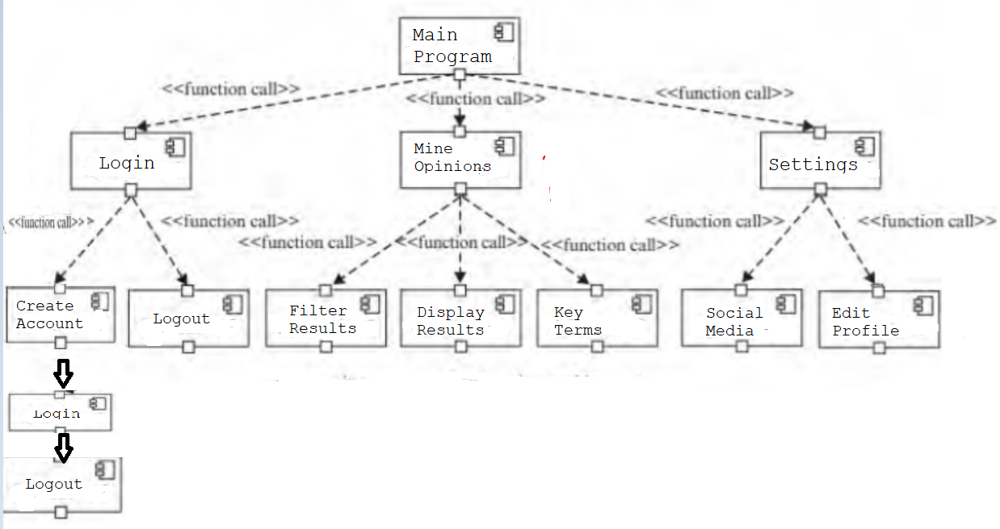
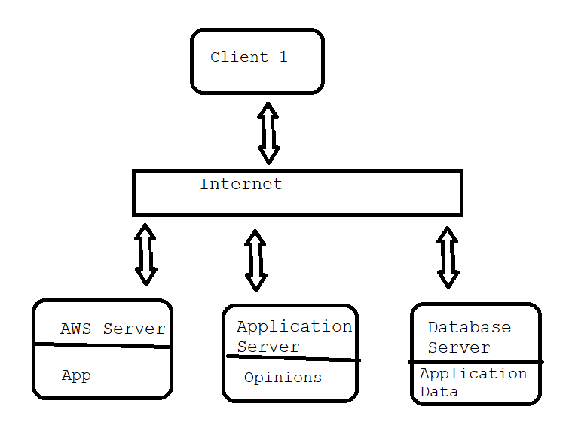
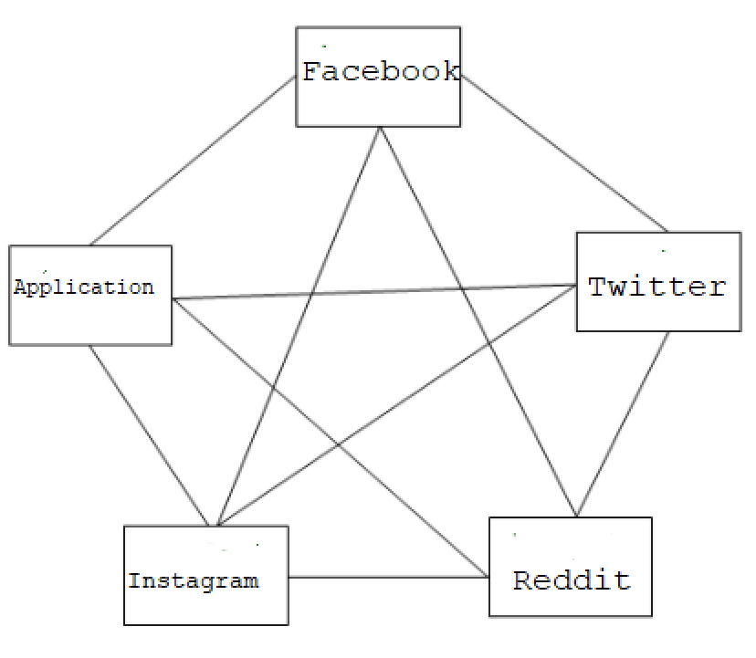
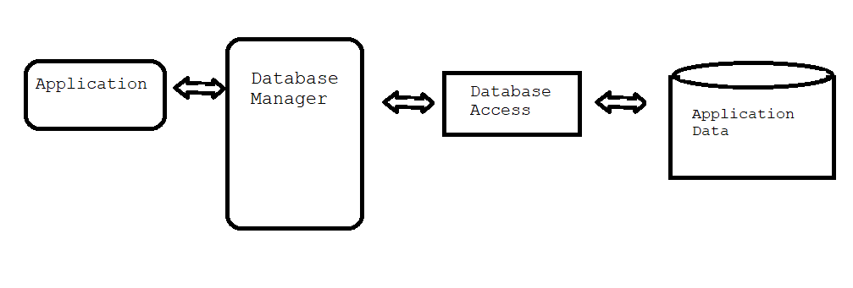
Architecture diagrams
Main programs and subroutines
Client server
Peer To peer
Persistence framework
Notes:
Supposed to fit on 1 slide, required to add in what style they are

Slide 32
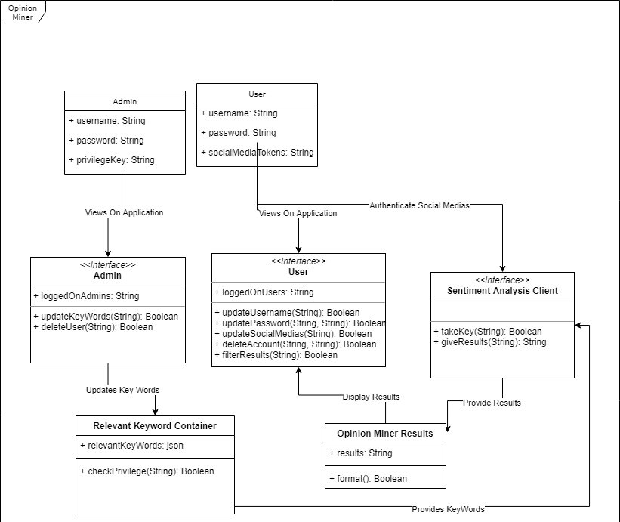
UML Classes & Associations

Slide 33
Action Register
Notes:
Update as needed

Slide 34
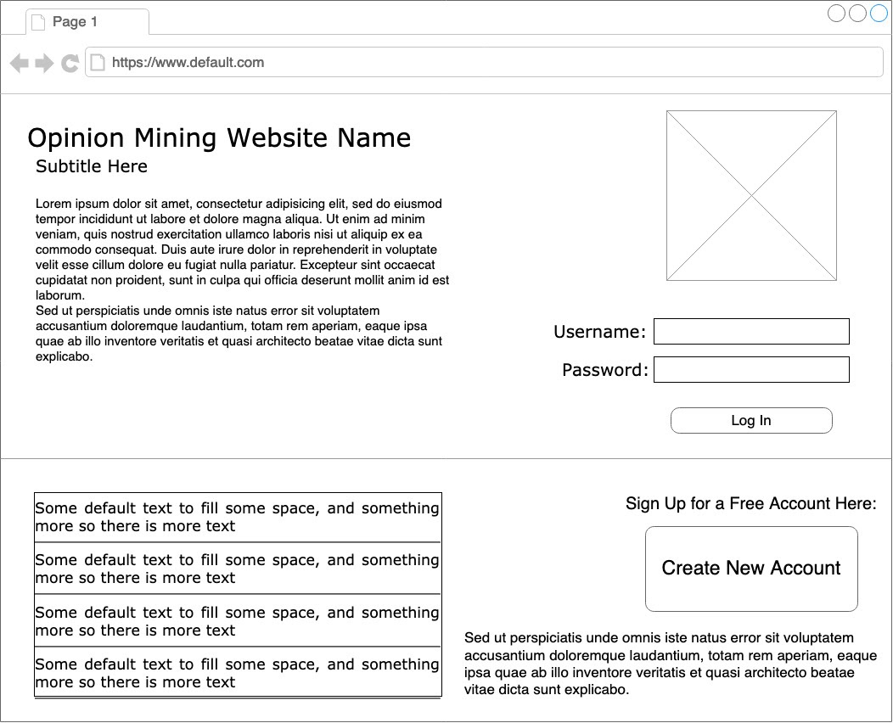
Wire frames: Logon page

Slide 35
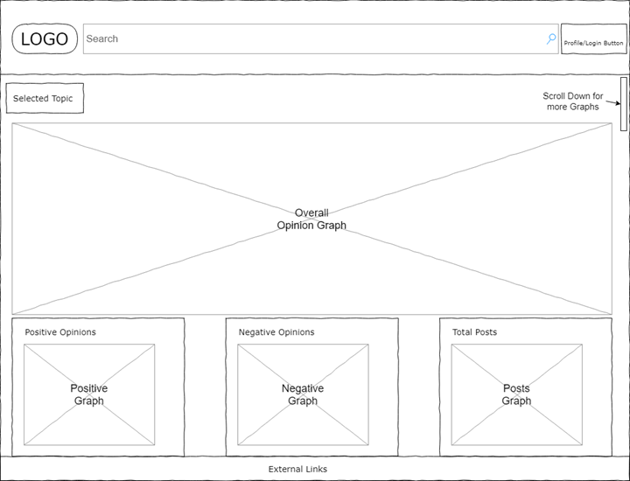
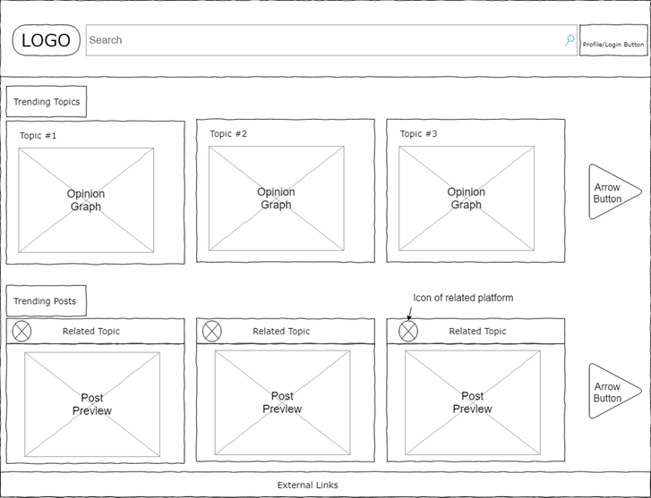
Wire frames
homepage
Topic data view

Slide 36
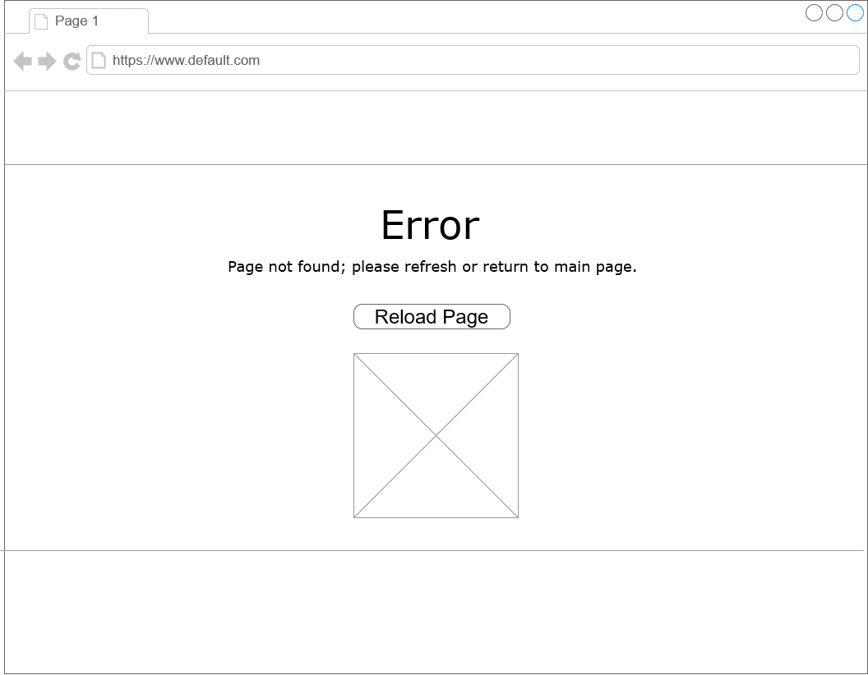
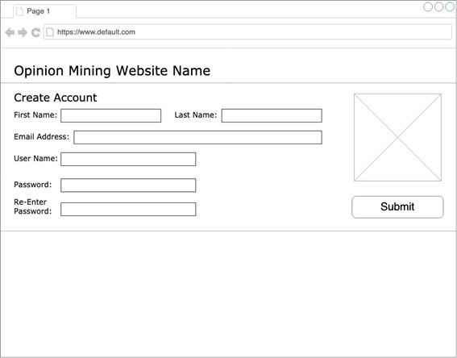
Wire frames
Create account
Error page

Slide 37
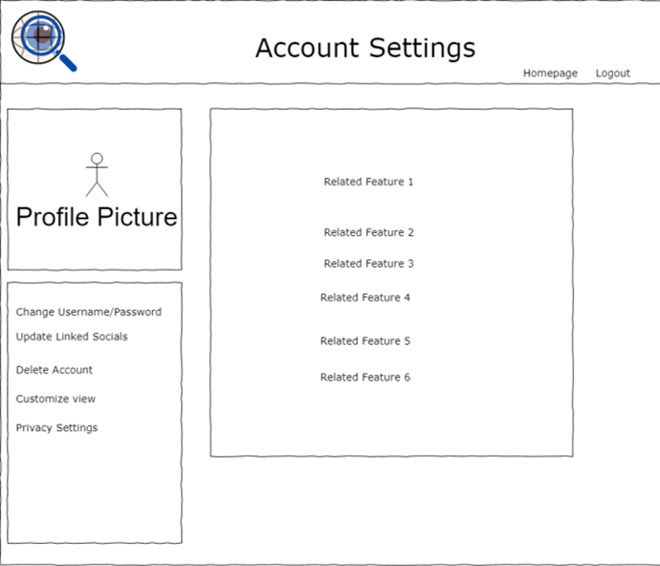
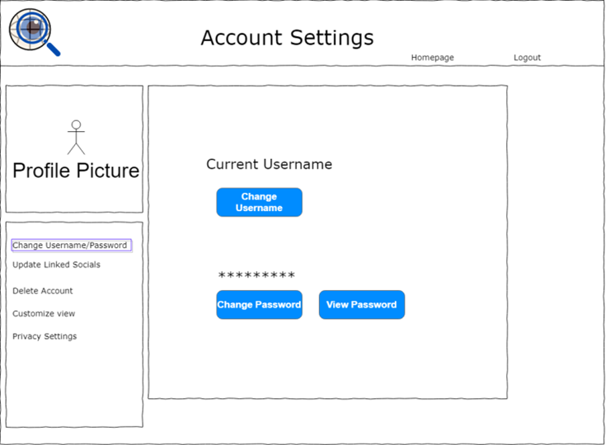
Wire frames
Change username/ password
Account settings

Slide 38
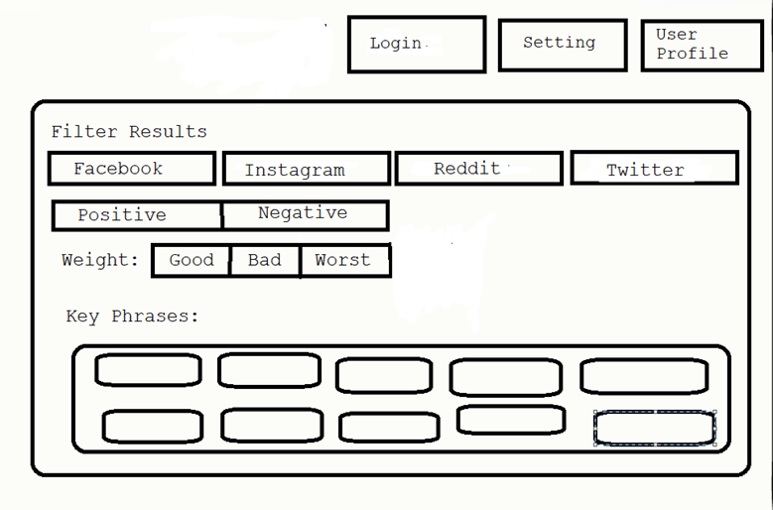
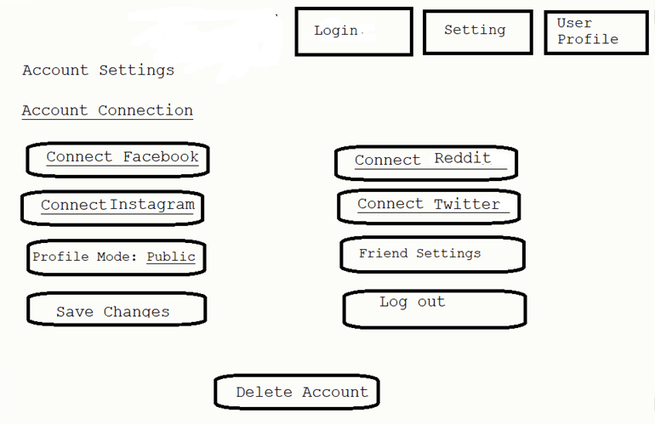
Wire frames
Privacy account settings
Filter search results menu

Slide 39
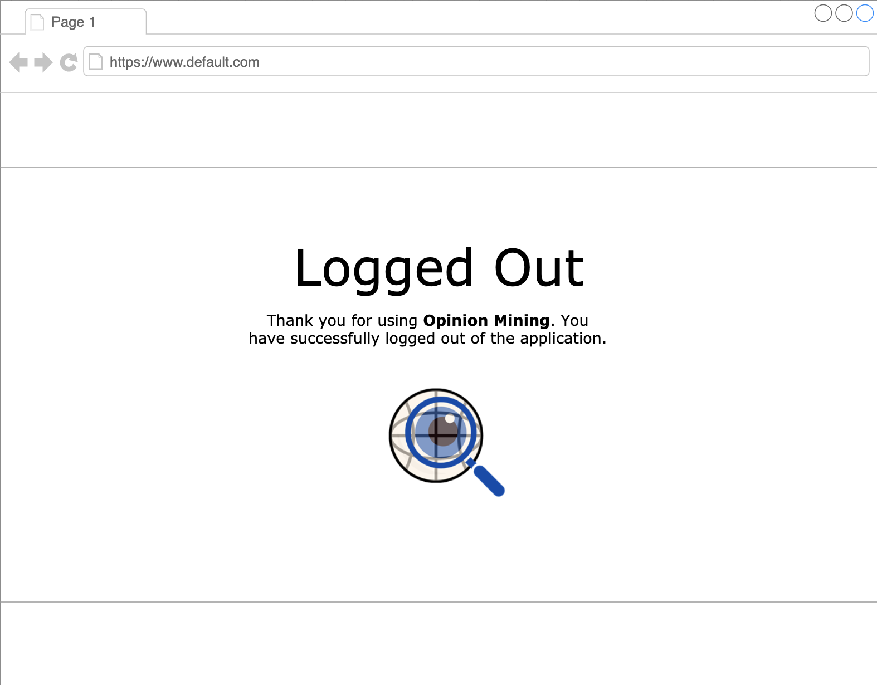
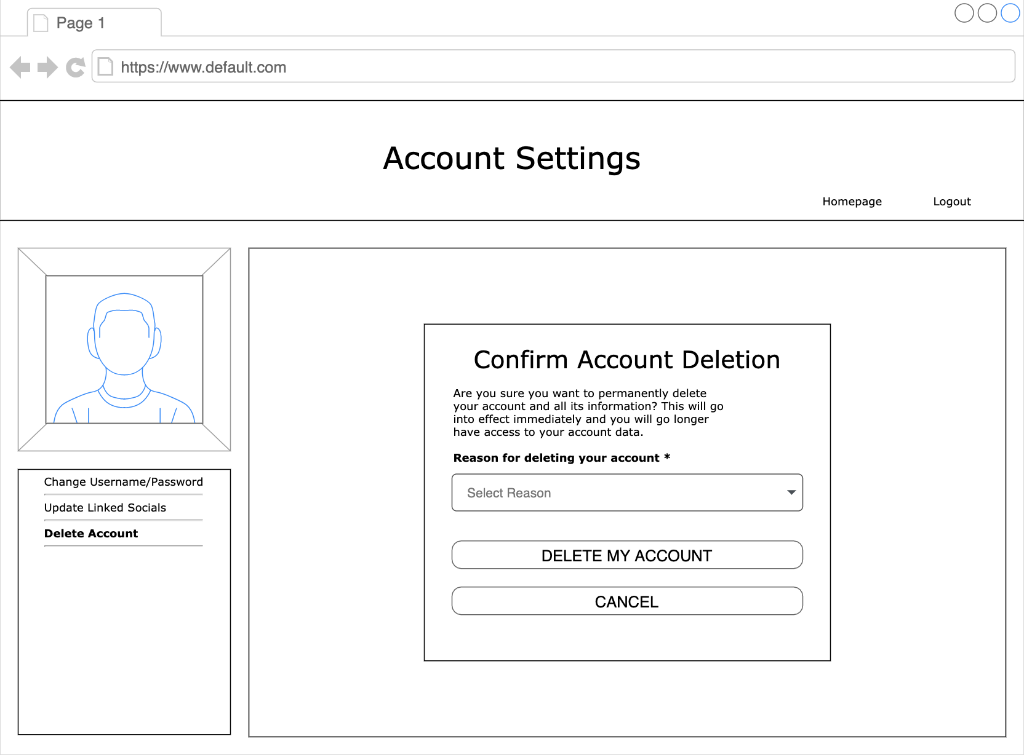
Wire frames
Account deletion
Logout
confirmation

Slide 40
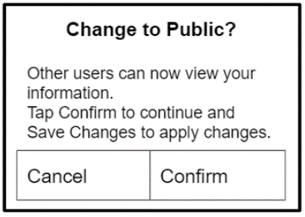
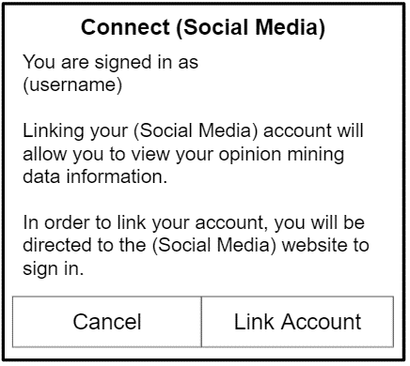
Wire frames
Connect social media
Change profile mode

Slide 41
Action Register
Notes:
Update as needed

Slide 42
Development Research
Scrum
Agile
Adaptable
2-week development cycle (sprints)
Quick regular meetings
High quality, low risk product
Product produced in a shorter amount of time
Early & regular feedback
Dependent on teams working quickly
Loss of any team member impacts project’s progress.
Minimized risk when adding new functionality
Product developed in iterations
Completing small increments of needed functionality
Improves efficiency
Corrections made early on
Dependent on:
Consistent communication
Time commitment
Labor intensive

Slide 43
Development Plan
Front-end:
HTML, CSS, and JavaScript.
Basis of many websites
Back-end:
JavaScript and FeathersJS
Important to handle large amount of data for the graphs and statistics
Language and a framework to convert data into graphs and statistics seamlessly.
Unit Testing Plan:
Handled in sprints
Ensures progress won’t affect team’s ability to accomplish goals in time.
Primarily based on Black Box testing and White Box testing methodology
Testing done with and without knowledge of the code to ensure that debugging is done properly

Slide 44
Action Register
Notes:
Update as needed

Slide 45
Deployment Strategies
Scrum
Agile
2-week work cycle aka sprints
Adaptable
High quality, low risk product
Product produced in a shorter amount of time
Loss of any team member impacts project’s progress.
Completing small increments of needed functionality
Improves efficiency
Dependent on:
Consistent communication
Time commitment
Labor intensive
Chosen Strategy: Scrum

Slide 46
Deployment Plan
Download:
Github code
Feathers (web framework)
NodeJS
npm
Next, install dependencies with:
cd path/to/opinion-miner
npm install
Start website with:
npm start
Run:
npm test
Subsequent Deployments Procedure:
Continually monitor that servers and databases stay connected as website is running
Update the application as soon as changes are made to the source code on Github

Slide 47
Test Results
Test Cases | Inputs | Expected Outputs | Actual Outputs
Create Account | Enter the information that is requested by the website | User is redirected to the homepage of the website. | User is redirected to the homepage of the website.
Go to Login Page | Click hyperlink for website | User is redirected to the sign in page. | User is redirected to the sign in page.
Login | Type username and password inputs, and click the login button. | User is redirected to the homepage of the website. | User is redirected to the homepage of the website.
Invalid Login | Type invalid username and password inputs, and press the login button. | User stays on the login page of the website, and an error message pops up. | User stays on the login page of the website, and an error message pops up.
Save login info | Click “Save Login Info” checkbox | Save user information at login if checked, and stop saving user information if unchecked | Does not save user information at login if checked

Slide 48
Test Results
Test Cases | Inputs | Expected Outputs | Actual Outputs
See search results | Type something into search bar and press enter | A list of results for the searched terms | Nothing shows up since the search engine is not functional
Filter search results | Choose filter options and click “Confirm” | Filters search results by filter options | Does not filter search results (no search engine)
View comments by weight class | Click “Good”, “Bad”, or “Worst” to view comments with corresponding weight class | Filters comments by weight class (Shows only Good, Bad, or Worst comments) | Does not filter by weight class (no comments or weight classes)
View Trending Topics | Click “Trending Topics” | Redirect to page with trending search topics | Does not redirect (No trending topics page)
Block user | Click “Block” on user profile | Block said user from viewing your profile | Does not block user (no users and no block button)

Slide 49
Test Results
Test Cases | Inputs | Expected Outputs | Actual Outputs
Go to linked account profile page | Click “Profile Page” | Redirect to page with all linked account profile information | Does not redirect to page (no profile page)
View other Public Profiles | Click someone’s Public Profile | Display profile information for said user | Does not display user information (because there are no other users)
Go to User Settings | Press “Settings” Button | Redirect to User Settings page | Redirects User to Settings page
Update Setting | Changes current settings and click the Confirm Settings | User is redirected to the Settings page, and the setting is updated. | User is redirected to the Settings page, and the setting is updated.
Switch account between Public and Private | Click the “Make Account Private” Checkbox | Switch checkbox from unchecked to checked (switch from public to private) if unchecked, and switch from checked to unchecked (switch from private to public) if checked | Checkbox switches, but account is not switch between public and private

Slide 50
Test Results
Test Cases | Inputs | Expected Outputs | Actual Outputs
Link social media account | Click any of the “Link” buttons in the settings page | Redirect to login page for corresponding social media account | Redirects to error page
Unlink Social Media accounts | Click on the “link button” in the settings page to disconnect the social media account after having connected a social media | Social Media is disconnected and redirected to disconnect social media page. | Redirect to the error page
Delete Account | Press the delete account button. | User is redirected to the sign in page. | User is redirected to the sign in page.
Logout | Click the logout button | User is redirected to the login page. | User is redirected to the login page
View Logout Confirmation Page | Click the logout button after you have been signed in | Displays Logout confirmation page | Does not display logout confirmation

Slide 51

Link to Code
https://github.com/mpstinnett/Opinion-Miner
https://opinion-miner-331800.appspot.com/

Slide 52
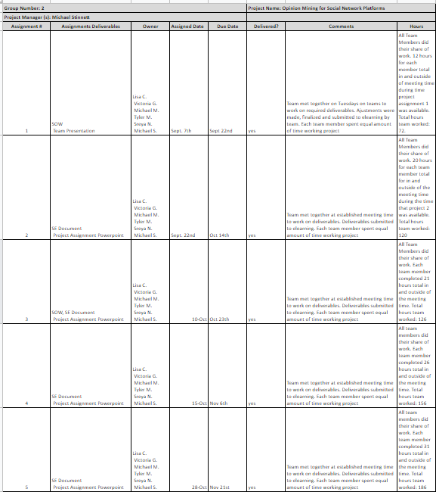
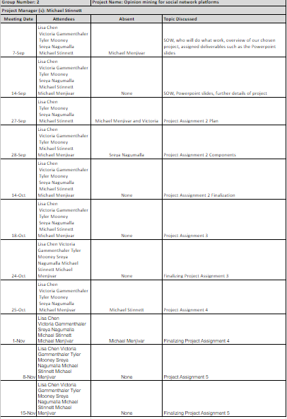
Action Register
Notes:
Update as needed

